Slide 1
Focus on Student Learning
Quality Assurance
Accreditation!!!!
Higher Learning Commission Update
Self-Study Lock Date – September 26th. Submitted on September 23rd.
Will post on MyMountMary public home page Monday, October 10th.
The Peer Review Team is meeting today; any additional requests for information and visit agenda will follow.
Please be on campus Monday, October 24th & Tuesday the 25th!

Slide 2
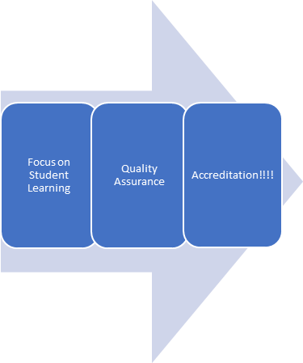
HLC Site Visit Overview
Assurance Argument Review Process:
Once the Assurance Argument is locked – the reviewers will start their work.
As they review, they will identify additional information that they would like included.
Each reviewer is assigned one primary and one secondary Criterion.
Prior to the visit, a good team will have a draft of the review.

Slide 3
HLC Site Visit Overview
During the Visit:
The team will be looking to affirm that what we said in the argument matches what they see.
They will be looking at what they found intriguing – areas of focus (not necessarily bad).

Slide 4
HLC Site Visit Overview
During the Visit – what will the team be doing?
Sunday Evening – meet and plan for visit.
Monday – will be on campus during the day; and writing at night!
Tuesday morning on campus, Tuesday p.m. and Wednesday a.m. writing.
At the end of the visit, a good team will have a draft of the final review.

Slide 5
HLC Site Visit Overview
After the Visit:
The team will finalize their review.
We will have an opportunity to correct errors of fact.
The final review will be completed 4-6 weeks following the visit.
Final decision by the HLC Institutional Action Council at the earliest, January 9th - 10th meeting, maybe February 27 - 28 meeting (or even later).

Slide 6
HLC Site Visit Overview
How we approached writing the Assurance Argument:
Being positive and highlighting our strengths while........
Being honest about areas where we see opportunities for improvement.
Articulating what we do through documented evidence.
How we, as a community, can best approach the visit:
Same as above!

Slide 7
HLC Site Visit Overview
Expectations of the Mount Mary Community:
Please attend open sessions that are most relevant for you.
Be able to articulate the Mission of Mount Mary.
Be honest with the reviewers.
Know retention, persistence and graduation goals! – Cheat sheet will be provided with important information.
You don’t need to know everything, but you should be able to talk about your own area and work (including providing documents if requested).

Slide 8
HLC Site Visit Overview
What you might be asked:
Criterion 1 - Mission!
Criterion 2 - Integrity: Ethical and Responsible Conduct
Criterion 3 - Teaching and Learning: Quality, Resources, and Support
Criterion 4 - Teaching and Learning: Evaluation and Improvement
Criterion 5 - Institutional Effectiveness, Resources, and Planning

Slide 9
HLC Site Visit Overview
Opportunities to meet with five peer reviewers:
Open Fora:
Criterion 1
Criteria 2 & 5
Criteria 3 & 4
Drop-in sessions.
A peer reviewer may request time to speak with you one on one.
Who else are they meeting with?
Board of Trustees
President's Council

Slide 10
HLC Site Visit Overview
Expectations for peer reviewers​:
Peer reviewers do not​............
Share information about the institution beyond the HLC.​
Identify individuals as sources of information.​
Peer reviewers​............
Are looking to affirm that the institution meets the criteria​.
Are looking within the context of the Mission​.
Care about higher education​.

Slide 11
HLC Site Visit Overview
Thank you to all who contributed writing on the core criteria teams!!!! Also, those who responded happily to all our urgent, strange requests!!!!
Criterion 1: S. Joan Penzenstadler, Katie Coffey & Christine Pharr
Criterion 2: Kristen Carioti & Pam Owens
Criterion 3: Marmy Clason, Stephanie Beisbier & Wendy Weaver
Criterion 4: Deb Dosemagen & Keri Alioto
Criterion 5: David Smith, Jan Prusha, LeeAnn Perkins & Karen Friedlen
All areas: Leah Adams-Curtis & Karen Friedlen

